Slide 1


Addressing Bias, Prejudice, Prejudgment & Conflicts of Interest
Dr. Lyda Costello Kiser,
Civil Rights and Title IX Coordinator

Slide 2
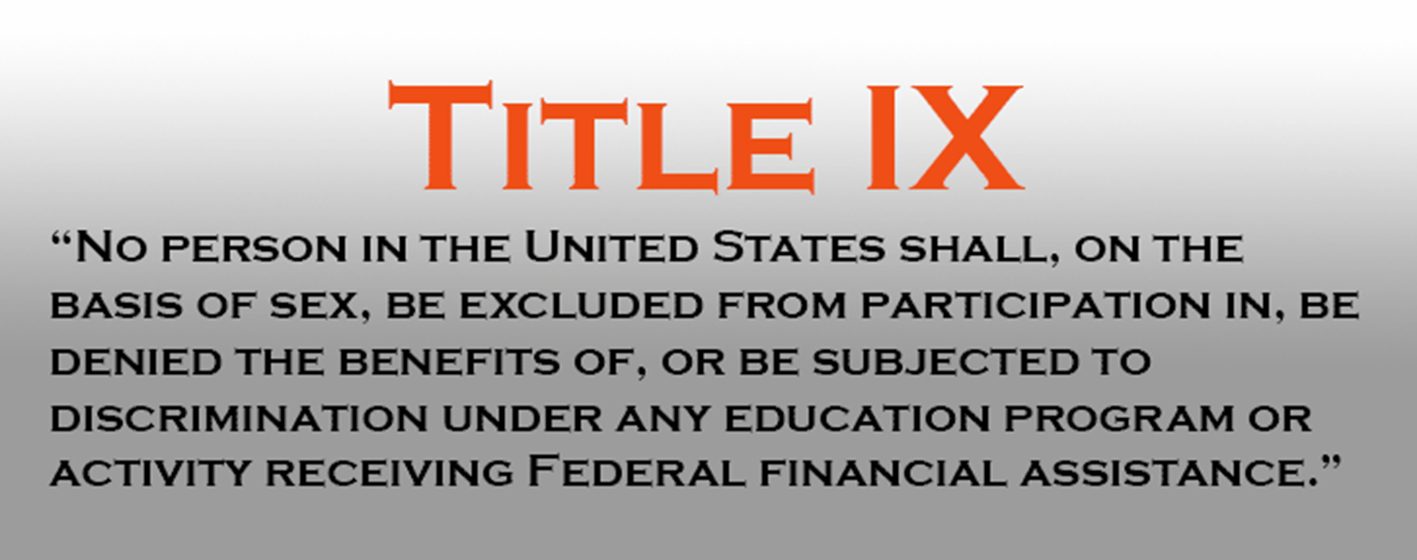


Slide 3
Upstate Policy
Title IX sexual harassment/misconduct includes (but is not limited to) sexual harassment, gender-based discrimination, non-consensual contact, non-consensual sexual intercourse, sexual exploitation, intimate partner violence and stalking.
Can be found in its entirety online:
Policy Against Discrimination, Harassment and Sexual Misconduct
https://uscupstate.edu/wp-content/uploads/2024/04/Dec.-1-Revised-Civil-Rights-and-Title-IX-Policy-003.pdf

Slide 4
Upstate Policy
Adheres to the requirements of the US Department of Education
Uses a Preponderance of the Evidence Standard
Always provides supportive services
Uses a virtual live hearing, with parties in separate locations
Applies to events/programs away from campus & situations where someone would reasonably assume the event was University-sponsored or sponsored by a registered organization
Includes protections to pregnant students, including childbirth, recovery, complications, and any type of pregnancy loss & its recovery

Slide 5
This presentation will review issues of bias, prejudice, prejudgment and conflictsUSC-Upstate’s Policy Against Discrimination, Harassment & Sexual Misconduct

Slide 6
USC-Upstate’s Commitment
USC-Upstate is committed to ensuring ALL our processes are free from:
Bias (gender, race, ethnicity, orientation, affiliation, etc.)
Prejudice
Prejudgment
Sex Stereotyping

Slide 7
It’s not whether you have biases….
It’s recognizing what they are and addressing them if they show up
Unaddressed bias = Conflict of Interest
This includes whether an individual is an athlete, works for the University, is a member of a Greek organization, is in a certain program, is from a specific location, or their relationship to known others

Slide 8
How our processes work to minimize bias/conflicts of interest:
Vet investigators for possible prior knowledge of an individual
Use an external Hearing Officer
Use an Appeal Officer who has not been previously involved in the case
List of pertinent information provided to individuals before assignment as an investigator, advisor, hearing officer, or appeal officer
Due process throughout
Always assume alleged individual is not responsible until the evidence is available

Slide 9
What to do if you believe you have a conflict of interest:
Notify the Title IX Coordinator immediately
Provide details of why you believe a conflict might exist
Do not discuss the potential conflict with any of the parties (if necessary, the Title IX Coordinator will do this)

Slide 10
Appeals can be based on bias/conflict of interest
This is why each individual assigned will be asked to address potential conflicts
This is important to the integrity of our process

Slide 11
Remember…
Our process works best when everyone proceeds with professionalism and fairness to all involved.
Your role is vital to ensuring due process for all.
Awareness is the key.
Your work is appreciated and important!

Slide 12
This information is an overview of this topic
There are separate presentations on process, policy, definitions, and various roles in the process
Read the actual policy and process documents to assist you in whatever role you may have

Slide 13
Need more information?
Lyda Costello Kiser
Civil Rights & Title IX Coordinator
lydak@uscupstate.edu or titleix@uscupstate.edu
Library 117B 864-503-7193

