Slide 1


Credibility in the Title IX Process
Dr. Lyda Costello Kiser,
Civil Rights and Title IX Coordinator

Slide 2
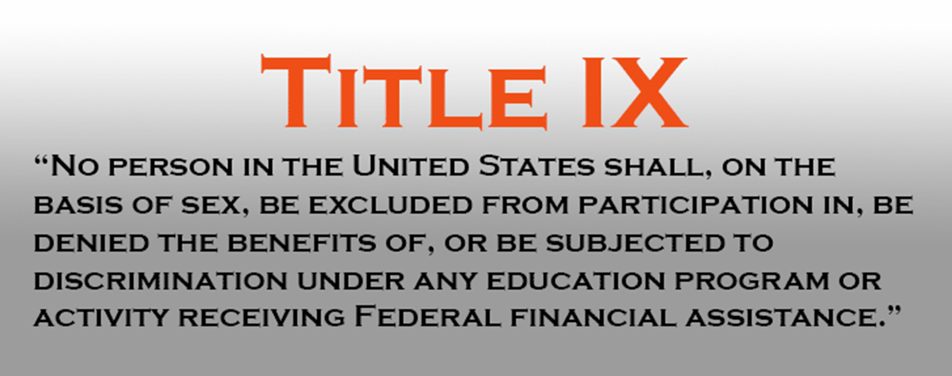


Slide 3
Upstate Policy
Title IX sexual harassment/misconduct includes (but is not limited to) sexual harassment, gender-based discrimination, non-consensual contact, non-consensual sexual intercourse, sexual exploitation, intimate partner violence and stalking.
Can be found in its entirety online:
Policy Against Discrimination, Harassment and Sexual Misconduct
https://uscupstate.edu/wp-content/uploads/2024/04/Dec.-1-Revised-Civil-Rights-and-Title-IX-Policy-003.pdf

Slide 4
This presentation will review credibility in the process for USC-Upstate’s Policy Against Discrimination, Harassment & Sexual Misconduct

Slide 5
Upstate Policy
Adheres to the requirements of the US Department of Education
Uses a Preponderance of the Evidence Standard
Always provides supportive services
Uses a virtual live hearing, with parties in separate locations
Applies to events/programs away from campus & situations where someone would reasonably assume the event was University-sponsored or sponsored by a registered organization
Includes protections to pregnant students, including childbirth, recovery, complications, and any type of pregnancy loss & its recovery

Slide 6
What is credibility?
Definition of “credibility” from Miriam Webster:
1. the quality or power of inspiring belief
2. capacity for belief
In the Title IX process, credibility refers to the process of weighing the accuracy and veracity of evidence.
Credibility and honesty are not identical terms

Slide 7
What role does credibility play in Title IX?
Credibility gives weight to evidence
All evidence must be evaluated for credibility in terms of the strength of source, content, and plausibility
Credible evidence is used to determine responsibility findings
The whole point to the process is to identify whether an incident (or incidents) were policy violations and credible evidence provides the support for a decision

Slide 8
Who determines credibility?
Investigators assess credibility;
Hearing Officers determine credibility
Investigators and Hearing Officers both ask questions that may go to credibility
Investigators provide information that can support or contradict credibility of a source
Only the Hearing Officer(s) make a final determination of credibility in the Title IX process

Slide 9
Barriers to assessing credibility
Bias towards members of a certain group – both positive & negative
Previous experience with the individual – both positive & negative
Inability to identify trauma-based responses and behaviors
Inability to separate personal morals/beliefs from the situation
False belief that witness corroboration is needed to establish credibility
Limited information
Interviewee fears sharing information

Slide 10
To assess credibility:
Evaluate the source, content, and plausibility of what is offered in light of other evidence.
If source, content, and plausibility are strong, credibility is strong.
The best way to establish credibility is through corroboration (sufficient independent evidence that supports the facts at issue)
Look for subtle bias of which individuals may not even be aware, including victim-blaming attitudes, group defensiveness (elg., within teams, organizations or departments), or whether the witnesses fear getting in trouble.
First-hand information – especially what is seen – is best. Neutral witnesses may be more credible than witnesses that are friends with either party, but not necessarily.

Slide 11
Some aspects of credibility are:
Positional/locational – could they have seen/heard what they claim from where they were?
Based on knowledge/expertise – this type of evidence/expertise needs to be properly qualified/established & typically includes information from medical providers
Weighted, based on levels of corroboration and neutrality/impartiality/objectivity – camera recordings may carry more weight than an individual’s statement

Slide 12
If you say evidence isn’t credible, are you calling someone a liar?
No. This is an objective evaluation.
Like critical thinking, the evaluation is of the source, content, and plausibility
Remember, how someone recalls an incident is through their perspectives
Example – if someone believes they have been harassed, they’ve been harassed. An individual’s experience is valid, but ther feelings/interpretation/reaction does not establish or prove that the conduct they experienced was a violation of policy.

Slide 13
Is there a quantifiable “credibility?”
Some say 50.1% = credible
Preponderance is the evidentiary standard we use – more likely than not a violation of policy occurred
It is important not to think in terms of absolutes (all or nothing)
It is expected that Hearing Officers will consider credibility factors extensively in deliberating findings – this is included in the written decision

Slide 14
Assessing Credibility (EEOC)
Factors to Consider
Inherent Plausibility – Is the testimony believable on its face? Does it make sense?
Demeanor – Did the person seem to be telling the truth? Lying?
Motive to falsify – Did the person have a reason to lie?
Corroboration – Is there other evidence that supports the information? What is the value of self-corroboration?
Past Record – Does the party have a history of similar behavior?

Slide 15
Assessing Credibility (EEOC)
Additional Considerations:
Consideration of Bias – Overt and subtle (Explicit and Implicit) & Group defensiveness
Analysis of Micro-expressions, Body Language & Gesticulations Be aware, but leave actual interpretation to the experts
Inconsistencies and Contradictions in statements – Major vs Minor
Lying – Why the lie? Consider motivation & reason, but beware of “all-or-nothing” evaluation of the individual

Slide 16
Assessing Credibility (EEOC)
Delay in Reporting – Why the delay? Are there more recent incidents? Fear of retribution?
Changes in individual’s behavior following the incident – Are examples provided? Is there evidence of trauma? Is there evidence of corrective behaviors or statements?
Witnesses told immediately about the incident - These are “outcry” witnesses
Witnesses raising additiona allegations about Respondent - relevant information vs. prejudicial information
Consensual relationships or consensual acts do NOT preclude non-consensual policy violations

Slide 17
Assessing Credibility (EEOC)
Also –
Complainant is not required to tell an alleged harasser to STOP, but that can be helpful information & effective in the moment.
Explanations for why the misconduct occurred – Explanation vs. Justification
Past history – Where does it fit? Does it fit?

Slide 18
Important to Remember
A “RESPONSIBLE” finding can be established when the evidence is credible and sufficient, even if there were no witnesses to the incident.

Slide 19
This information is about how credibility is used in Title IX processes
There are separate presentations on policy, process, definitions, and relevance
Read the actual policy and process documents to assist you in whatever role you may have

Slide 20
Need more information?
Lyda Costello Kiser
Civil Rights & Title IX Coordinator
lydak@uscupstate.edu or titleix@uscupstate.edu
Library 117B 864-503-7193

