Slide 1


Process Steps for Responding to Violations of the Discrimination, Harassment & Sexual Misconduct Policy
Dr. Lyda Costello Kiser,
Civil Rights and Title IX Coordinator

Slide 2
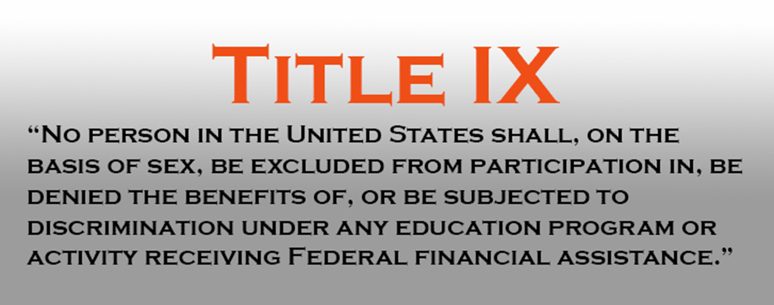


Slide 3
Upstate Policy
Title IX sexual harassment/misconduct includes (but is not limited to) sexual harassment, gender-based discrimination, non-consensual contact, non-consensual sexual intercourse, sexual exploitation, intimate partner violence and stalking.
Can be found in its entirety online:
Policy Against Discrimination, Harassment and Sexual Misconduct
https://uscupstate.edu/wp-content/uploads/2024/04/Dec.-1-Revised-Civil-Rights-and-Title-IX-Policy-003.pdf

Slide 4
This presentation will review the process steps for responses to alleged violations of USC-Upstate’s Policy Against Discrimination, Harassment & Sexual Misconduct

Slide 5
Policy:
The University of South Carolina Upstate is committed to providing an environment free from discrimination, harassment, sexual misconduct, and related retaliation. This commitment helps realize the university’s primary mission and aligns with institutional values and to comply with all requirements set forth by civil rights laws, including Title IX, and related federal and state authority.

Slide 6
Upstate Policy
Adheres to the requirements of the US Department of Education
Uses a Preponderance of the Evidence Standard
Always provides supportive services
Uses a virtual live hearing, with parties in separate locations
Applies to events/programs away from campus & situations where someone would reasonably assume the event was University-sponsored or sponsored by a registered organization
Includes protections to pregnant students, including childbirth, recovery, complications, and any type of pregnancy loss & its recovery

Slide 7
Language from the Process Document:
The University of South Carolina Upstate is committed to providing a prompt, fair, impartial, and equitable response to complaints of discrimination, harassment, sexual misconduct, and related retaliation all of which are prohibited by the university’s Policy Against Discrimination, Harassment & Sexual Misconduct. The university’s procedures for responding to prohibited conduct are grounded in fairness and support for all parties, include procedural protections that ensure notice, equitable opportunities to participate, and a neutral and impartial investigation, resolution, and appeal. These procedures establish the required practice for responding to a complaint through either an informal or investigative resolution and are meant to be read in conjunction with the university’s Policy Against Discrimination, Harassment & Sexual Misconduct. All individuals that conduct resolutions must comply with these procedures.

Slide 8
Goal of the Process
Determine if the policy has been violated
Conduct a fair and impartial investigation
Implement a prompt and effective remedy that:
Ends the discrimination/harassment
Prevents its recurrence
Addresses its effects

Slide 9
Report Received
Maxient (this is our online system)
UPD Report
Email
In-person disclosure
Phone

Slide 10
Immediate needs addressed
Health & Safety – includes medical attention, housing, support at work location, notification of UPD
On-Call Residential staff, Dean of Students, UPD, local law enforcement, Counseling, Health Services, Title IX could all be involved
Email to faculty and outreach to HR if requested

Slide 11
Review by Title IX
Title IX Coordinator (or Deputy) reviews the report to identify policy application, plan for outreach to the Complainant, and any additional information required
May add student(s) involved to CARE Team agenda
Complainant is contacted to discuss incident and identify needs

Slide 12
Histories of parties reviewed
For students, review of information in Maxient, Dean of Students’ records, UPD, course information, housing, organizational membership
For employees, HR reviews any information on prior/ongoing incidents, work location and schedule; may request UPD review

Slide 13
Complainant Contacted
Email, text, phone (usually also send letter via Maxient system for students)
Request for meeting to discuss incident
At meeting, offer services and explain options to the Complainant for moving forward (services only, informal process, formal process)
Complainant does NOT have to decide on process immediately

Slide 14
If Complainant decides to move forward…
Meet to discuss process and sign formal complaint
Discuss advisor options
Provide checklists, rights, process document
Notify Respondent
Hold meeting with Respondent – provide checklist, rights, process documents, discuss advisor
Determine if Investigative or informal process
Identify Investigator
Set up meeting with Investigator

Slide 15
Standard of Evidence
For informal and formal processes, Upstate uses the “preponderance of evidence” standard
This means that it is more likely than not that the incident occurred as reported
This standard is aligned with the University’s standards for other processes (i.e., Student Code of Conduct)

Slide 16
Informal Process
Must be agreed upon by all parties, in writing
Can include alternative/restorative processes
Each party has the right to end the process at any time prior to the resolution and return to the investigative process
Facilitated by a trained Resolution Officer
Parties may be accompanied by an Advisor
Typically, the Respondent admits responsibility and sanctions are of a lower level

Slide 17
Formal (Investigative) Process
Requires an investigation and a full hearing with cross-examination
Is required when an employee is reported for harassment towards a student
Respondent can, at any time, admit responsibility and move directly to sanctioning
Is NOT required for a party to receive supportive services
Parties are NOT required to participate, but non-participation may affect the ability of the process to move forward

Slide 18
Formal (Investigative) Process
Investigator identified – either external or internal employee
Address potential conflicts of interest or bias before beginning
Set up meetings with parties, witnesses, others with information
Prepare an Investigation Report with relevant information
Do NOT determine credibility or responsibility
DO determine relevance of evidence
Investigator compiles evidence for review by parties
Parties may submit a written response for the Investigator to consider before creating the Investigative Report

Slide 19
Investigative Process
After receiving the responses, the Title IX Coordinator and Investigator review the information to determine if there is a need for additional interviews
Investigative report provided to the Title IX Coordinator for review and distribution to parties and Decision Maker
Hearing is scheduled for no less than 10 business days after parties receive the report

Slide 20
Hearing Procedures
Conducted through live video (typically the Zoom platform)
Title IX staff provide support
Are recorded
Live cross-examination required, conducted by Advisors
Only questions deemed relevant by the Decision Maker/Hearing Officer may be answered
Includes Investigator, Parties, and any available Witnesses
The University will not require an individual to participate in the hearing

Slide 21
Decisions and Sanctions
The Hearing Officer/Decision Maker determines credibility, relevance, responsibility, and sanctions
Responsibility is determined using the preponderance of the evidence standard
A written determination is prepared, including the finding of responsibility or non-responsibility and rationale for each allegation, disciplinary sanctions, and whether remedies designed to restore/preserve equal access to the program/activity will be provided by the University to the complainant

Slide 22
Decisions & Sanctions
Sanctions must fall within those allowed by the University and are in addition to sanctions that may be implemented by teams, clubs, organizations, etc.
The written determination includes information and the appeals process, including bases for appeals
The written determination is provided to the Title IX Coordinator within five (5) days following the conclusion of the hearing
The Title IX Coordinator provides the written determination to the parties and their advisors simultaneously as soon as possible after receiving it

Slide 23
Appeals
Either or both party(ies) may appeal on the following bases:
i. Procedural irregularity that affected the outcome;
ii. New evidence that was not reasonably available at the time the determination was made that could affect the outcome;
iii. The Investigator(s), Resolution/Hearing Officer(s) or designee(s) had a conflict of interest or bias for or against Complainants or Respondents generally or the individuals specifically that affected the outcome.

Slide 24
Appeals
Appeal must clearly articulate that the request falls within one of the bases for appeal
The Civil Rights & Title IX Coordinator or designee will perform an initial review of the appeal
If the Civil Rights & Title IX Coordinator finds that at least one of the bases is clearly articulated, the appeal will proceed
An appeal officer is assigned
The other party is notified in writing and has the ability submit a written statement in support of or challenging the outcome

Slide 25
Appeals
The Appeal Officer will review the written information and possibly the hearing transcript
The Appeal Officer may uphold the original decision and/or sanction(s), Dismiss the case or individual finding and vacate any portion or all of the sanction(s), remand the case for investigation, remand the case to the original Hearing/Resolution Officer or refer to a new Officer to be reheard
The decision of the Appeal Officer is final (additional procedures may apply for matters involving faculty members)

Slide 26
This information is an overview of the process
There are separate presentations on definitions, specific roles, and specific components of the policy and process
Read the actual policy and process documents to assist you in whatever role you may have

Slide 27
Need more information?
Lyda Costello Kiser
Civil Rights & Title IX Coordinator
lydak@uscupstate.edu or titleix@uscupstate.edu
Library 117B 864-503-7193

