Slide 1


The Hearing Process for Title IX at USC-Upstate
Dr. Lyda Costello Kiser,
Civil Rights and Title IX Coordinator

Slide 2
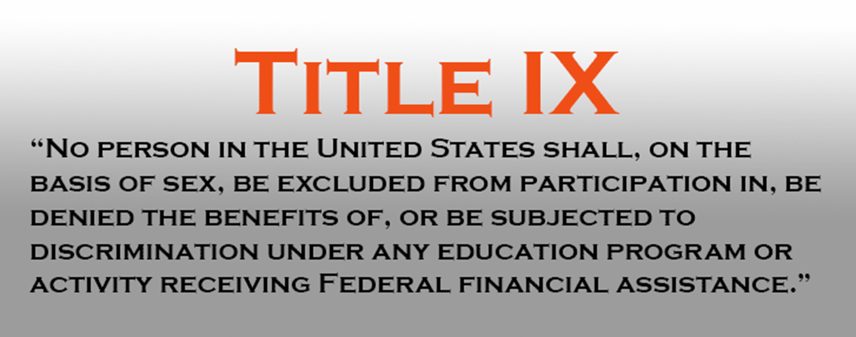


Slide 3
Upstate Policy
Title IX sexual harassment/misconduct includes (but is not limited to) sexual harassment, gender-based discrimination, non-consensual contact, non-consensual sexual intercourse, sexual exploitation, intimate partner violence and stalking.
Can be found in its entirety online:
Policy Against Discrimination, Harassment and Sexual Misconduct
https://uscupstate.edu/wp-content/uploads/2024/04/Dec.-1-Revised-Civil-Rights-and-Title-IX-Policy-003.pdf

Slide 4
This presentation will review the Hearing Process for USC-Upstate’s Policy Against Discrimination, Harassment & Sexual Misconduct

Slide 5
Upstate Policy
Adheres to the requirements of the US Department of Education
Uses a Preponderance of the Evidence Standard
Always provides supportive services
Uses a virtual live hearing, with parties in separate locations

Slide 6
Requirements from the 2020 Rule
Since August 2020, the regulations have required a live hearing process with cross-examination
While the hearing is live and in real time, USC Upstate uses a virtual platform so all parties and not in the same room
The Resolution/Hearing Officer is the decision maker and makes determination of credibility, relevance, responsibility, and sanctions

Slide 7
USC-Upstate’s Process
Title IX Staff provide support (communicating with witnesses, managing technology, providing supporting documents, etc.)
Will use the Zoom platform
Are recorded and the recording transcribed
Provides Breakout rooms for Hearing Officer and Coordinator, Complainant and Advisor, Respondent and Advisor
Utilizes Waiting Room for witnesses and investigator
Prior to the Hearing, parties and advisors meet with the Title IX Coordinator to discuss logistics/procedures/rules of decorum

Slide 8
Format for Hearing
Identification of all participants
Explanation of format and processes
Confirmation that no participant is recording the proceedings or has anyone present other than those identified at the opening
Review of allegations
Order of Witnesses – Investigator(s), Witnesses, Complainant, Respondent
Complainant and Respondent are allowed an opening statement prior to responding to questions

Slide 9
Format for Hearing, cont.
For each Investigator, witness and party – Resolution/Hearing Officer questions, Complainant questions, Respondent questions
Closing statements by the parties
Closing of Hearing – review timeline, dissemination of notice of decision, appeals process

Slide 10
Hearing Rules
The party will be the only person in the physical room from which they are joining virtually (unless with their advisor)
The advisor will be the only person in the physical room from which they are joining virtually (unless with the party)
Each witness will be the only person in the physical room from which they are joining virtually
All participants will keep their electronic devices muted until asked to speak
The Hearing Officer or Clerk may mute a participant, if appropriate

Slide 11
Hearing Rules, cont.
During the hearing, parties and advisors will communicate only with and at the direction of the Hearing Officer;
Parties and advisors may not communicate with any other participant in the hearing;
Cell phones should be turned off or silenced;
The only recording will be made by the University;
Abusive, intimidating, and obstructive conduct will not be tolerated (including profanity, bullying, aggressive language)
Advisors may only participate as consistent with policy

Slide 12
Hearing Rules, cont.
Questions may not be argumentative, badgering, or intended to intimidate or otherwise attach participants
Duplicative questions are not considered relevant
Advisors will not be allowed to make statements on behalf of the party
The Hearing Officer has the sole authority to determine relevancy of questions
The Hearing Officer may offer the opportunity to rephrase or restate the question

Slide 13
Title IX Role in Hearing
The Title IX Coordinator of Investigator can provide support to the process
The Title IX Staff will not determine relevance, credibility, or responsibility
Title IX Staff with communicate with witnesses in the waiting room, address technology issues, provide policy information, and otherwise support the Hearing Officer
Title IX staff will provide the parties with the Decision and information regarding appeals

Slide 14
The Decision
There is not a decision issued at the hearing, but is provided within 5 business days unless there are extenuating circumstances;
The Hearing Officer may consult with the Title IX Coordinator on draft language and sanctions in relation to University precedent
The Title IX Coordinator will provide the format for the Decision document for completion by the Hearing Officer
After submitting the Decision document to the Title IX Coordinator, the Coordinator shares the information with the parties

Slide 15
Appeals
The parties have 5 days to submit a written appeal following receipt of the decision
Appeals can only be based on:
Procedural irregularity that affected the outcome
New evidence that was not reasonably available at the time that could affect the outcome
The Investigator(s), Hearing Officer(s), or designee(s) had a conflict of interest or bias

Slide 16
This information is an overview of the Hearing Process
There are separate presentations on definitions, policy, process, and the components of the process
Read the actual policy and process documents to assist you in whatever role you may have

Slide 17
Need more information?
Lyda Costello Kiser
Civil Rights & Title IX Coordinator
lydak@uscupstate.edu or titleix@uscupstate.edu
Library 117B 864-503-7193

